Slide 1
Operators and Expression
Thanks to
Nakib Hayat Chowdhury

Slide 2
Operators and Operands
Arithmetic Operator
Relational Operators
Logical Operators
Assignment Operators and
Unary Operators
Conditional Operators
Bitwise Operators
Special Operators
The data items that operators act upon, are called operands.

Slide 3
Arithmetic Operators
There are five arithmetic operators in C. They are
There is no exponentiation operator in C.
There is a library function (POW) under math.h to carry out exponentiation
Operator | Purpose
+ | Addition
- | Subtraction
* | Multiplication
/ | Division
% | Reminder after integer division

Slide 4
Arithmetic Operators (cont.)
The operands acted upon by arithmetic operators must represent numeric values.
Thus, the operands can be integer quantities, floating-point quantities or characters
Character constant represent integer value

Slide 5
Arithmetic Operators (cont.)
The remainder operator (%) requires that both operands be integers and the second operand be nonzero.
Similarly, the division operator (/) requires that the second operand be nonzero.

Slide 6
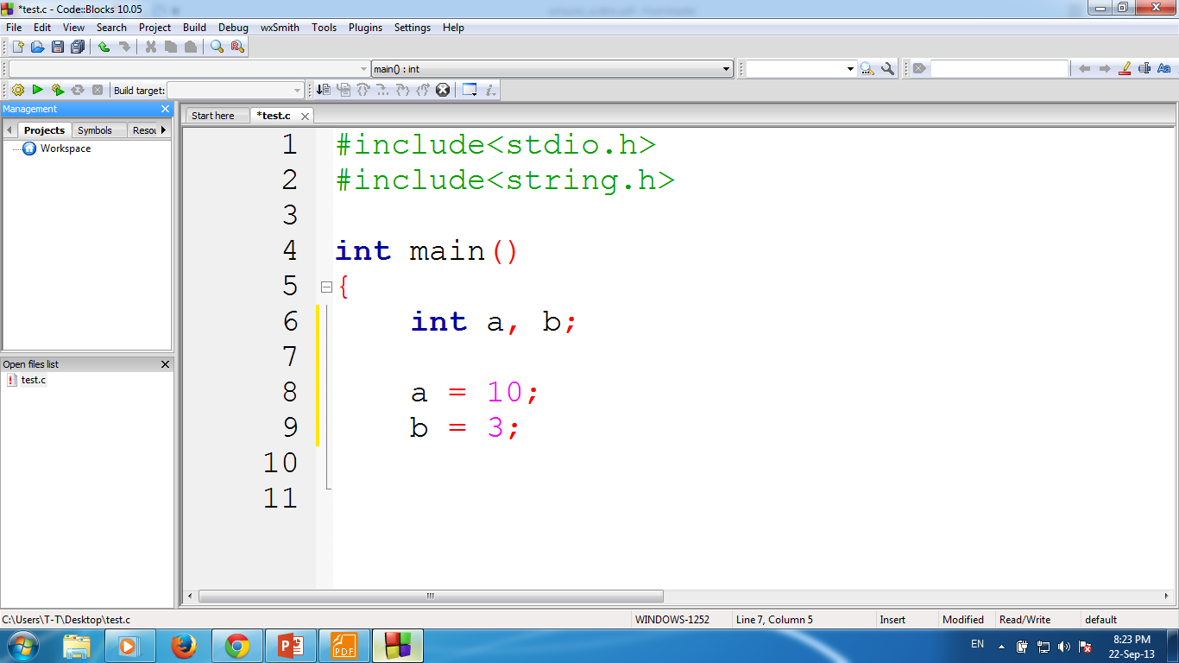
a + b
13
a - b
7
a * b
30
a / b
3
Here, the decimal portion of the quotient will be dropped
a % b
1

Slide 7
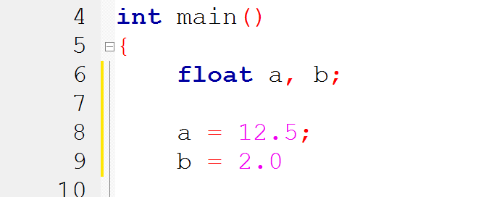
a + b
14.5
a - b
10.5
a * b
25.0
a / b
6.25
a % b
Not Possible!!!

Slide 8

a
65
a + b
131
a + 1
66
a + ‘A’
130
a + ‘1’
114

Slide 9
int a, b;
a = 11;
b = -3;
Follow basic rules of algebra
a + b
8
a - b
14
a * b
-33
a / b
-3
a % b
2
Ignore - !!!

Slide 10
Type Convention
Operands that differ in type may undergo type conversion before the expression takes on its final value.
In general, the final result will be expressed in the highest precision possible, consistent with the data types of the operands.
Rules apply when neither operand is unsigned.

Slide 11
int i = 7;
float f = 5.5;
char c = ‘w’
ASCII Value
w = 119
0 = 48
i + f
12.5
float (double)
i + c
126
integer
i + c – ‘0’
78
integer
(i + c) - (2 * f / 5)
123.8
float (double)

Slide 12
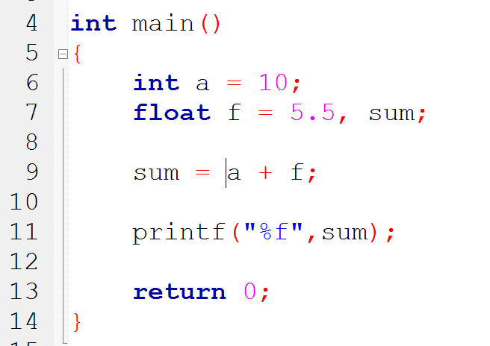
Type conversion

Slide 13
Type Convention
If the two operands in assignment expression are of different data types.
The value of right hand operand will automatically be converted to the type of the operand on the left.
The entire assignment expression will be then same data type.
We will learn detail later
11.995
Left
3
float
int
Right
int
float
Left
float
3.0
int
11
;
;
;

Slide 14
Type Cast
To transform the type of a variable temporarily.
To do so, the expression must be preceded by the name of the desired data type, enclosed in parentheses
(data type) expression
int number;
(float) number;

Slide 15
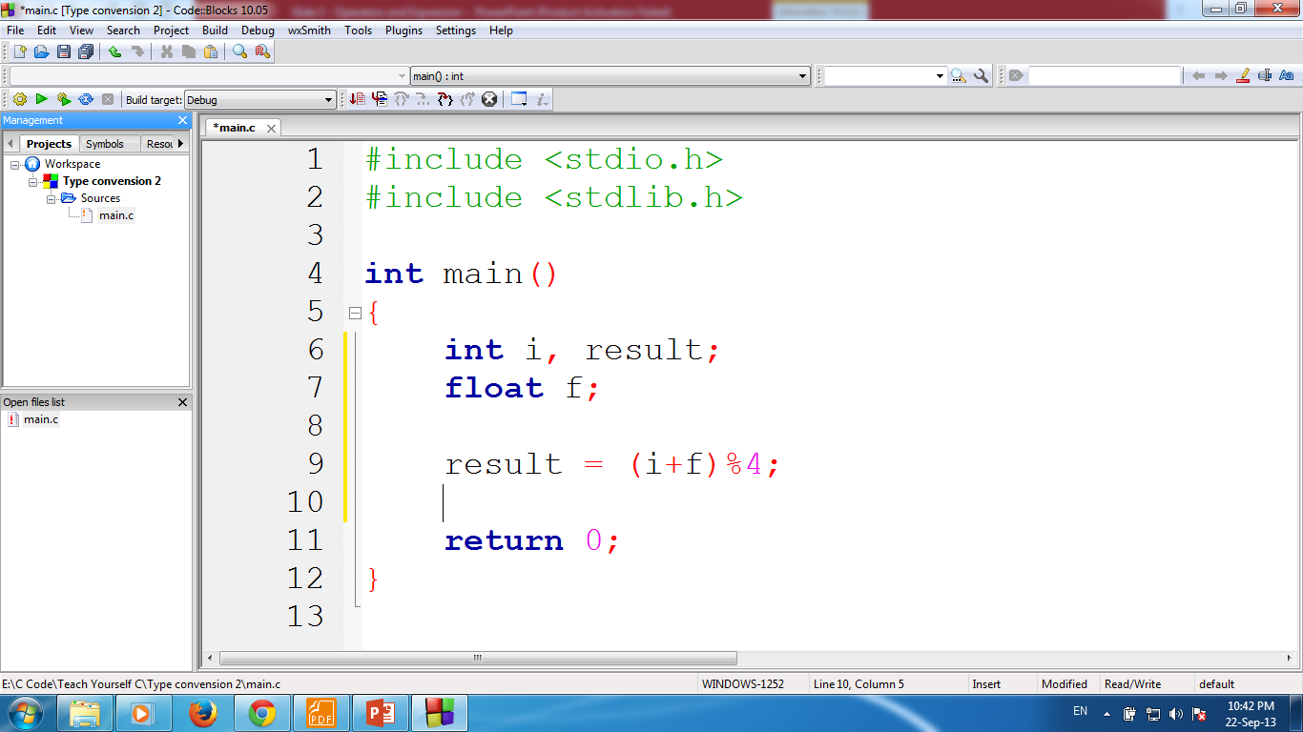
Valid or Invalid?
Type conversion 2
i = 7;
f = 8.5;
Invalid
result = (i + f) % 4;

Slide 16

Valid or Invalid?
float num = 10.5;
num % 2;
float num = 10.5;
((int)num) % 2;

Slide 17
Relational Operators
Use to compare two values.
Operator | Meaning
< | is less than
<= | is less than or equal to
> | is greater than
>= | is greater than or equal to
== | is equal to
!= | is not equal to

Slide 18
Relational Operators…
These six operators are used to form logical expressions, which represent conditions that are either true or false.
The resulting expressions will be of type integer
True is represented by the integer value 1
False is represented by the value 0

Slide 19
Relational Operators
Example | Description
A < B | True if A is less than B else False
A <= B | True if A is less than or equal B else False
A > B | True if A is greater than B else False
A >= B | True if A is greater than or equal B else False
A == B | True if A is equals to B else False
A != B | True if A is equals to B else False

Slide 20
True or False
i = 1
j = 2
k = 3
Expression
Result
Value
i < j
true
1
(1 + j) >= k
true
1
(j + k) > (i + 5)
false
0

Slide 21
True or False
i = 1
j = 2
k = 3
Expression
Result
Value
k != 3
false
0
j == 2
true
1
(j + k) >= (i + 5)
false
0

Slide 22
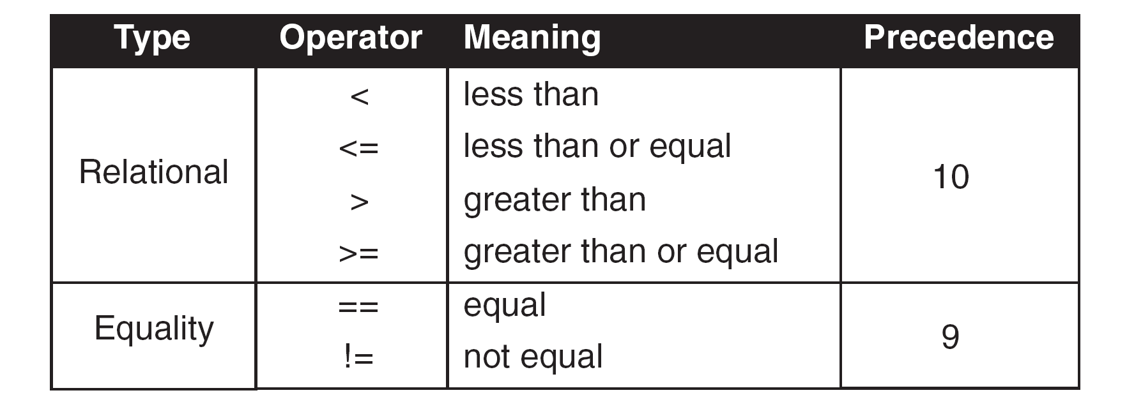
Precedence

Slide 23
Each One is Complement of Another

Slide 24
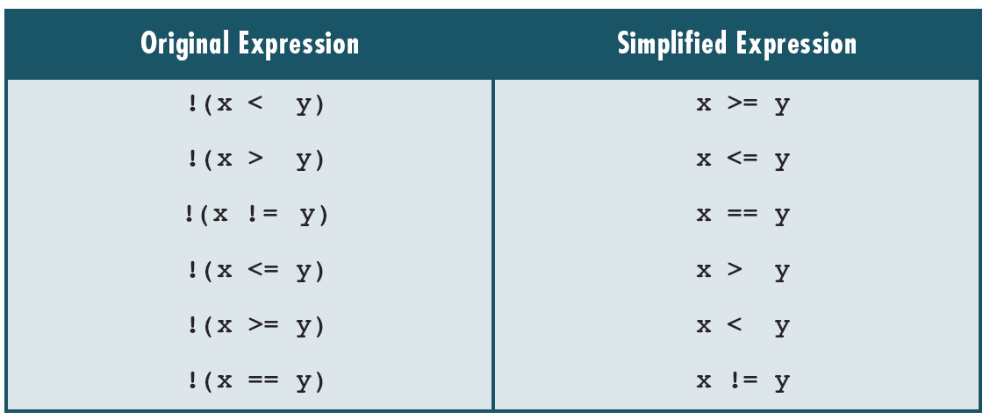
Simplified Expression

Slide 25
Logical Operation
There are three kinds of logical operators.
Operators | Meaning Logical
&& | AND
|| | OR
! | NOT

Slide 26
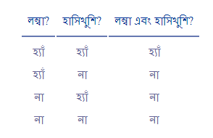
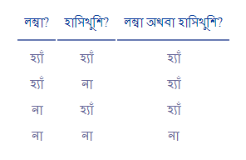
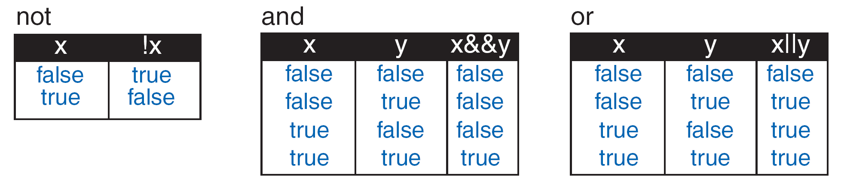
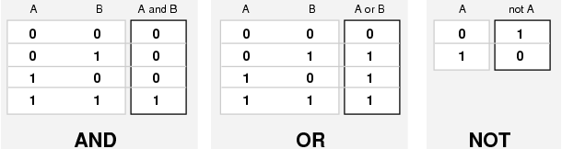

Slide 27
True or False!

Slide 28
True or False
i = 7
f = 5.5
c = ‘w’ (119)
Expression
Result
Value
(i >= 6) && (c == 'w')
true
1
(i >= 6) || (c == 119)
true
1
(f < 11) && (i > 100)
false
0

Slide 29
Precedence
Operator | Precedence
! | Highest
> >= < <=
== !=
&&
|| | Lowest

Slide 30
Assignment Operators
Use to assign the result of an expression to a variable.
Most common “=“
Remember: = and == are not same!
Other five are:
+=
-=
*=
/=
%=

Slide 31
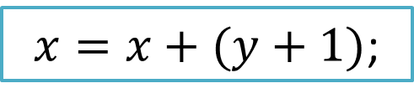
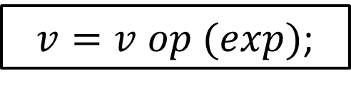
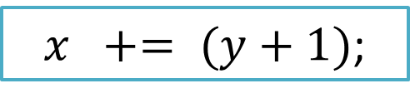
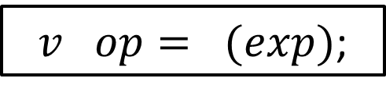
Shorthand Assignment Operator
If we have an assignment statement as follow-
We can written this as-
$v=v op (exp)$;
$x=x+(y+1)$;
$v op= (exp)$;
$x += (y+1)$;

Slide 32
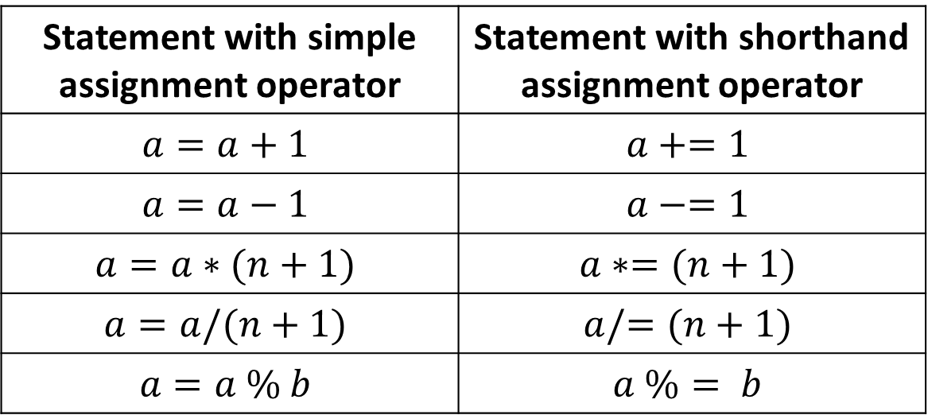
Shorthand Assignment Operator
Statement with simple assignment operator | Statement with shorthand assignment operator
$$a=a+1$$ | $$a+=1$$
$$a=a−1$$ | $$a−=1$$
$$a=a∗(n+1)$$ | $$a∗=(n+1)$$
$$a=a/(n+1)$$ | $$a/=(n+1)$$
$$a=a \% b$$ | $$a \%= b$$

Slide 33
Advantage of Shorthand Operators
The use of shorthand assignment operators has three advantages:
What appears on the left-hand side need not be repeated, so easier to write.
The statement is more concise and easier to read.
The statement is more efficient.

Slide 34
Unary Operators
Operators that act upon a single operand to produce a new value are Known as unary operators.

Slide 35
Increment and Decrement Operator
++ and --
The ++ add 1 to the operand and -- subtracts 1.
Both are unary operators and takes the form:
++m; or m++;
--m; or m--;
++m; is equivalent to m = m + 1; (or m += 1;)
--m; is equivalent to m = m - 1; (or m -= 1;)

Slide 36
++m; vs m++;
++m and m++ mean the same thing when they form statements independently.
m = 5;
++m;
m = 6
m = 5;
m++;
m = 6
++m; is equivalent to m = m + 1; (or m += 1;)
--m; is equivalent to m = m - 1; (or m -= 1;)

Slide 37
++m; vs m++;
If ++m and m++ used on the right-hand side of an assignment statement, they behave differently.
m = 5;
y = ++m;
m = 6
y = 6
m = 5;
y = m++;
m = 6
y = 5
++m; is equivalent to m = m + 1; (or m += 1;)
--m; is equivalent to m = m - 1; (or m -= 1;)

Slide 38
++m; vs m++;
A prefix operator (++m) first adds 1 to the operand and then the result is assigned to the variable to the variable on left.
A postfix operator first operator first assigns the value to the variable on left and then increments the operand.

Slide 39
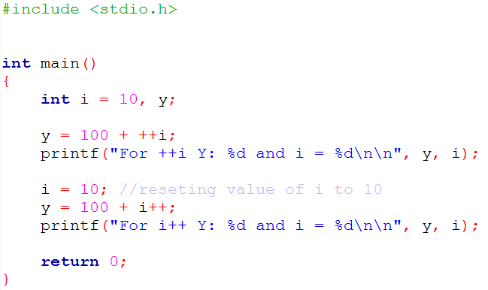

++m; vs m++;
Program

Slide 40
Conditional Operators
exp1 ? exp2 : exp3
We will discuss it in slide 5!

Slide 41
Bitwise Operator
Operator | Meaning
& | Bitwise AND
| | Bitwise OR
^ | Bitwise exclusive OR
<< | Shift left
>> | Shift right
We will learn later!

Slide 42
Special Operators
C supports some special operators of interest
Comma operator ( , )
Sizeof operator (sizeof(v))
Pointer operators ( & and * )
Member selection operator ( . and ->)

Slide 43
The Comma Operator
The comma operator can be used to link the related expressions together.
Evaluated left to right
The value of right-most expression is the value of the combined expression.
x = 10;
y = 5;
value = x+y;
value = (x=10, y=5, x+y;)

Slide 44
Find the value of t
Evaluated left to right
The value of right-most expression is the value of the combined expression.
z
t = x, t = y, t = z;

Slide 45
The sizeof Operator
This a compile time unary operator.
Returns the number of bytes the operand occupies.
The operand may be-
a variable
a constant
A data type qualifier
m = sizeof(sum);
n = sizeof(2358);
k = sizeof(double);

Slide 46
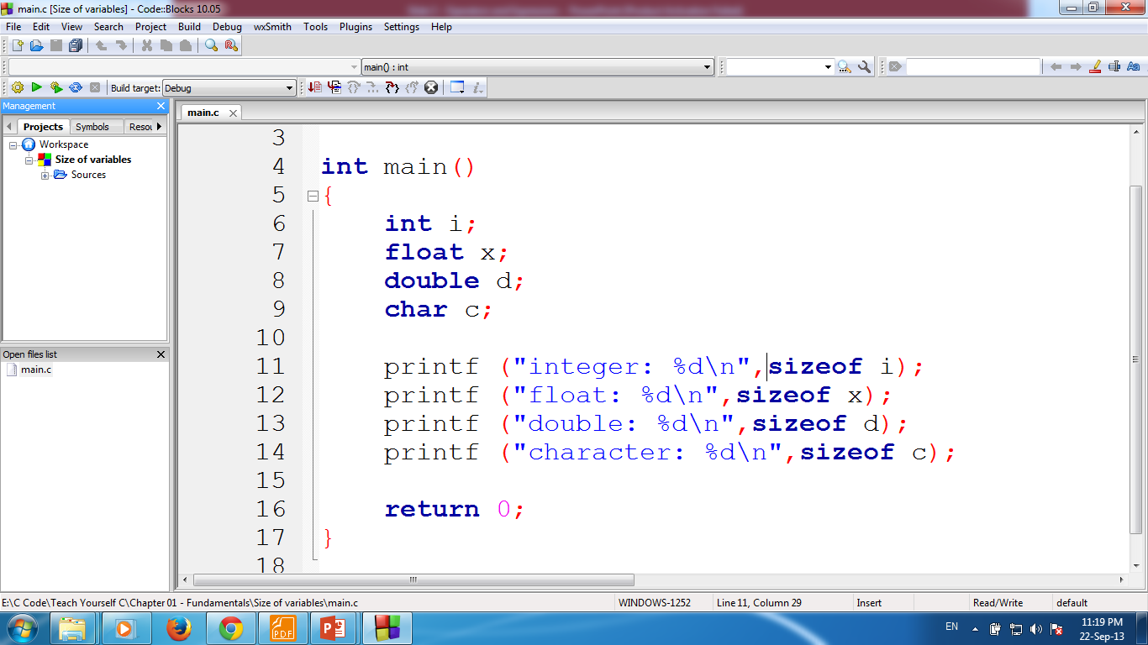
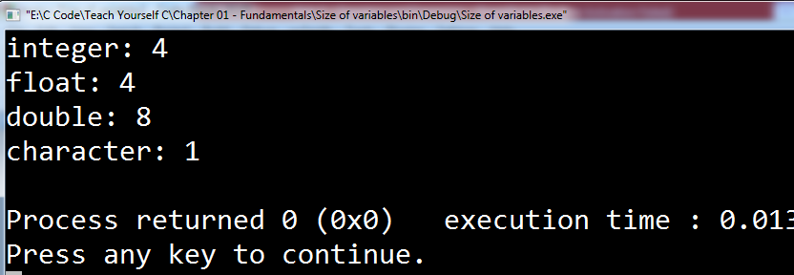

Slide 47
Type Conversion In Expression
Implicit Type Conversion
Explicit Conversion
We will learn later!

Slide 48
Operator Precedence and Associativity
Precedence is used to determine how an expression involving more than one operator is evaluated.
There are distinct levels of precedence
An operator may belong to one of these levels
The operators at higher level of precedence are evaluated first.
The operators of the same precedence are evaluated either from ‘left to right’ or from ‘right to left’.
This is known as associativity property of an operator.
Notes:
x == 10 + 15 && y < 10

Slide 49
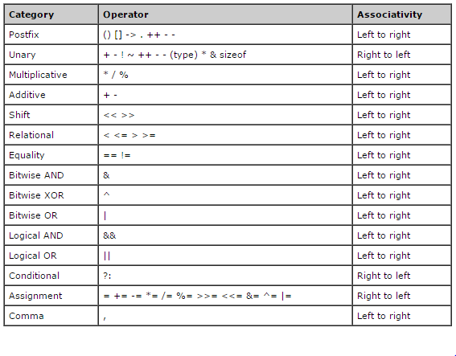
Operators Precedence
Notes:
Table 3.8 page 72 (ANCI C)

Slide 50
Some Computational Problem
Computer gives approximate values for real numbers that can cause serious problem.
Another problem is division by zero.
Overflow and Underflow

Slide 51
Home Task
Write your own program using this math functions
sin(x)
ceil(x)
exp(x)
fabs(x)
floor(x)
fmod(x,y)
pow(x,y)
sqrt(x)
Or/and google it!

